Slide 1
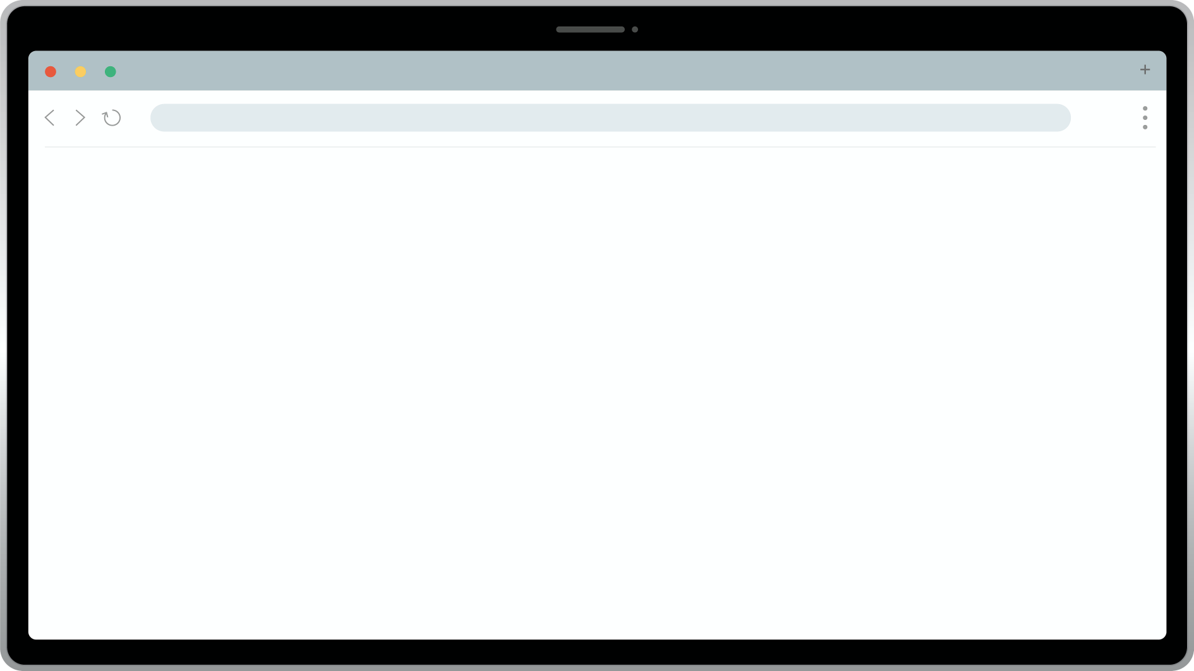





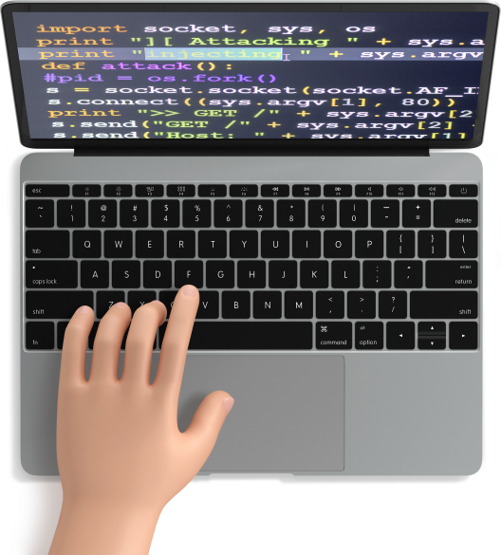

File Edit View Option
2080.06
MIRICOMPANY.COM
1
2
3
4
5
6
7
8
9
10
11
12
13
14
15
16
17
18
19
20
21
// Welcome to the Coding Plan
console.log("Developer's Programming Plan");
{
;
중급자를 위한
JS 프로그래밍
// Ready to Start?
console.log("Next Page");
------------------------------------------------------------------------------------------------------------
------------------------------------------------------------------------------------------------------------

Slide 2





File Edit View Option
2080.06
MIRICOMPANY.COM
1
2
3
4
5
6
7
8
9
10
11
12
13
14
15
16
17
18
19
20
21
목차
// Table of Contents
const contents = [
CONTENTS 01
CONTENTS 02
CONTENTS 03
INDEX
변수
함수,메소드
심볼,슬라이스
00_Index Page
"Project Overview"
"Project Features"
"Technology Stack"
PROGRAMMING PLAN
CONTENTS 04
CONTENTS 05
CONTENTS 06
배열
나머지 매개변수
클로저
"Team Responsibilities"
"Development Timeline"
"Q & A"

Slide 3
File Edit View Option
2080.06
MIRICOMPANY.COM
1
2
3
4
5
6
7
8
9
10
11
12
13
14
15
16
17
18
19
20
21
목차
// Table of Contents
const contents = [
CONTENTS 01
CONTENTS 02
CONTENTS 03
INDEX
시간관련함수
call,apply,bind
상속
00_Index Page
"Project Overview"
"Project Features"
"Technology Stack"
PROGRAMMING PLAN
CONTENTS 04
CONTENTS 05
CONTENTS 06
클래스
프로미스
제너레이터
"Team Responsibilities"
"Development Timeline"
"Q & A"

Slide 4



File Edit View Option
2080.06
MIRICOMPANY.COM
1
2
3
4
5
6
7
8
9
10
11
12
13
14
15
16
17
18
19
20
21
변수
// Project Features
FEATURE 01
PROGRAMMING PLAN
{
}
let,const,var
용도?
변수 종류
01_ Project Overview
02_Project Features
03_Technology Stack
04_Team Responsibilities
05_Development Timeline
FEATURE 02
06_Q & A
{
}
// var 1. 선언및 초기화 동시 2. 할당
// let 1.선언단계 2.초기화 단계 3. 할당 단계
// const 1.선언+초기화+할당 동시에
var는 함수 밖에서 사용가능 but let과 const 로 선언된 것은 불가능
차이점

Slide 5



File Edit View Option
2080.06
MIRICOMPANY.COM
1
2
3
4
5
6
7
8
9
10
11
12
13
14
15
16
17
18
19
20
21
함수
<!---->
<!-- "기술스택 안내" -->
PROGRAMMING PLAN
<!--생성자 함수-->
<!-- 객체 메소드 -->
<!-- Object.-->
------------------
function User(name,age){
//this ={}
this.name = name;
this.age = age;
//return this;
}
new 함수명();
01_ Project Overview
//생성자 함수 (첫번째 글자 대문자 관례
computed property
02_Project Features
객체 관련 함수들
03_Technology Stack
------------------
let a ='age';
const user{
name : 'Mike',
[a] : 30;
}
04_Team Responsibilities
------------------
//키 배열 반환
Object.keys()
//값 배열 반환
Object.values()
//[키,값] 배열 반환
Object.entires();
05_Development Timeline
06_Q & A

Slide 6

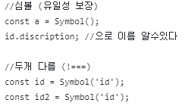
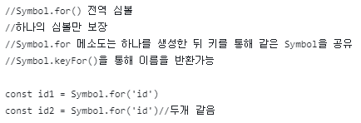
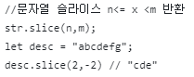
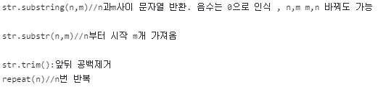
File Edit View Option
2080.06
MIRICOMPANY.COM
1
2
3
4
5
6
7
8
9
10
11
12
13
14
15
16
17
18
19
20
21
심볼,슬라이스
// Team Responsibilities
<!-- FRONT END -->
PROGRAMMING PLAN
심볼 ex)
01_ Project Overview
02_Project Features
03_Technology Stack
04_Team Responsibilities
05_Development Timeline
<!-- BACK END -->
06_Q & A
슬라이스 ex)
* 페이지 내 인물 사진은 샘플이미지 입니다.

Slide 7
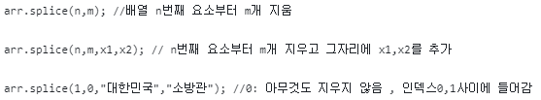
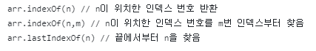
File Edit View Option
2080.06
MIRICOMPANY.COM
1
2
3
4
5
6
7
8
9
10
11
12
13
14
15
16
17
18
19
20
21
배열
// Team Responsibilities
<!-- FRONT END -->
PROGRAMMING PLAN
배열 메소드 ex)
01_ Project Overview
02_Project Features
03_Technology Stack
04_Team Responsibilities
05_Development Timeline
<!-- BACK END -->
06_Q & A
배열 메소드 ex)
* 페이지 내 인물 사진은 샘플이미지 입니다.

Slide 8
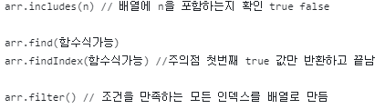
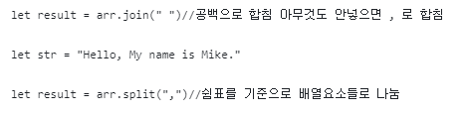
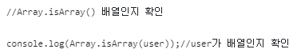
File Edit View Option
2080.06
MIRICOMPANY.COM
1
2
3
4
5
6
7
8
9
10
11
12
13
14
15
16
17
18
19
20
21
배열
// Team Responsibilities
<!-- FRONT END -->
PROGRAMMING PLAN
배열 메소드 ex)
01_ Project Overview
02_Project Features
03_Technology Stack
04_Team Responsibilities
05_Development Timeline
<!-- BACK END -->
06_Q & A
배열 메소드 ex)
* 페이지 내 인물 사진은 샘플이미지 입니다.

Slide 9
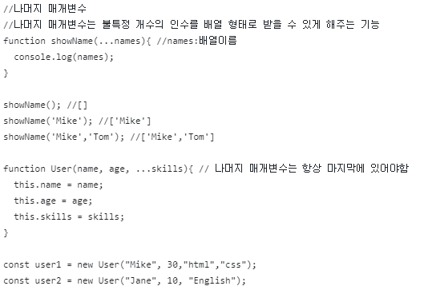
File Edit View Option
2080.06
MIRICOMPANY.COM
1
2
3
4
5
6
7
8
9
10
11
12
13
14
15
16
17
18
19
20
21
나머지 매개변수
// Team Responsibilities
<!-- FRONT END -->
PROGRAMMING PLAN
나머지 매개변수 ex)
01_ Project Overview
02_Project Features
03_Technology Stack
04_Team Responsibilities
05_Development Timeline
<!-- BACK END -->
06_Q & A
* 페이지 내 인물 사진은 샘플이미지 입니다.

Slide 10
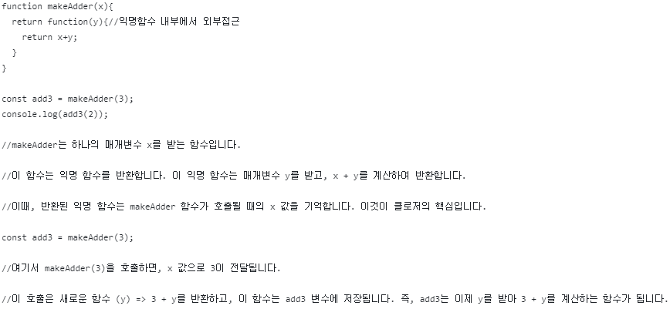
File Edit View Option
2080.06
MIRICOMPANY.COM
1
2
3
4
5
6
7
8
9
10
11
12
13
14
15
16
17
18
19
20
21
클로저
// Team Responsibilities
<!-- FRONT END -->
PROGRAMMING PLAN
클로저 ex)
01_ Project Overview
02_Project Features
03_Technology Stack
04_Team Responsibilities
05_Development Timeline
<!-- BACK END -->
06_Q & A
* 페이지 내 인물 사진은 샘플이미지 입니다.

Slide 11
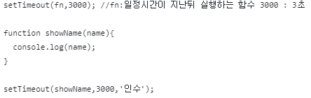
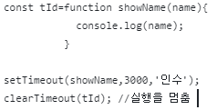
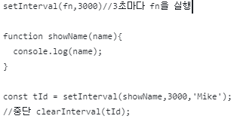
File Edit View Option
2080.06
MIRICOMPANY.COM
1
2
3
4
5
6
7
8
9
10
11
12
13
14
15
16
17
18
19
20
21
시간관련 함수
// Team Responsibilities
<!-- FRONT END -->
PROGRAMMING PLAN
setTimeout
ex)
01_ Project Overview
02_Project Features
03_Technology Stack
04_Team Responsibilities
05_Development Timeline
<!-- BACK END -->
06_Q & A
setInterval
ex)
* 페이지 내 인물 사진은 샘플이미지 입니다.

Slide 12
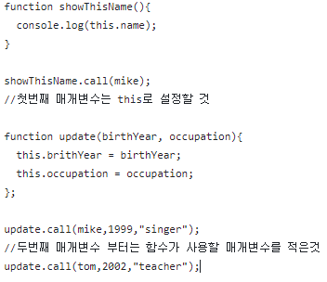
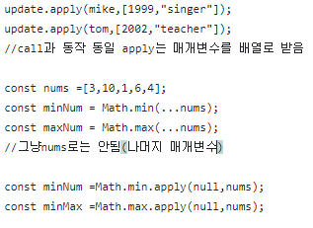
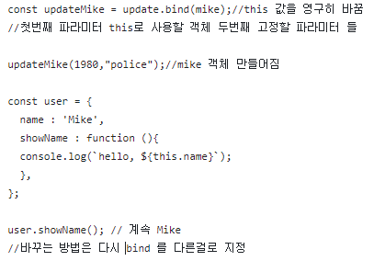
File Edit View Option
2080.06
MIRICOMPANY.COM
1
2
3
4
5
6
7
8
9
10
11
12
13
14
15
16
17
18
19
20
21
call,apply,
bind
<!---->
<!-- "기술스택 안내" -->
PROGRAMMING PLAN
<!--call-->
<!-- apply -->
<!-- bind-->
01_ Project Overview
02_Project Features
03_Technology Stack
04_Team Responsibilities
05_Development Timeline
06_Q & A

Slide 13
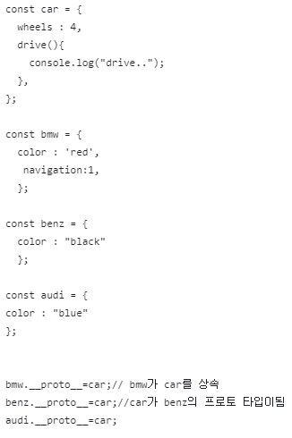
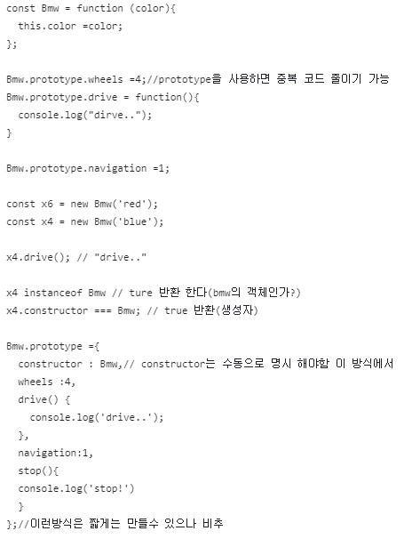
File Edit View Option
2080.06
MIRICOMPANY.COM
1
2
3
4
5
6
7
8
9
10
11
12
13
14
15
16
17
18
19
20
21
// Team Responsibilities
상속
<!-- FRONT END -->
PROGRAMMING PLAN
상속 ex)
01_ Project Overview
02_Project Features
03_Technology Stack
04_Team Responsibilities
05_Development Timeline
<!-- BACK END -->
06_Q & A

Slide 14
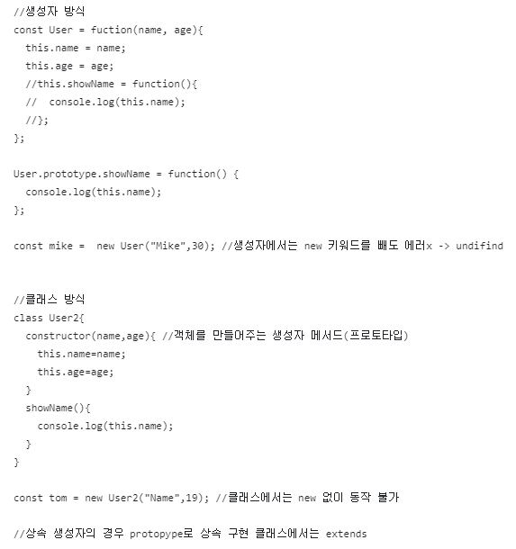
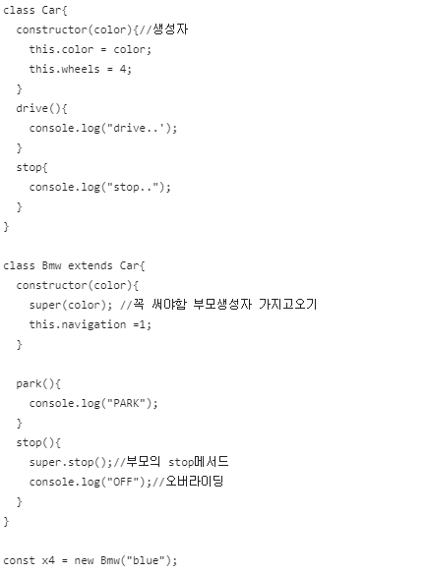
File Edit View Option
2080.06
MIRICOMPANY.COM
1
2
3
4
5
6
7
8
9
10
11
12
13
14
15
16
17
18
19
20
21
// Team Responsibilities
클래스
<!-- FRONT END -->
PROGRAMMING PLAN
클래스 ex)
01_ Project Overview
02_Project Features
03_Technology Stack
04_Team Responsibilities
05_Development Timeline
<!-- BACK END -->
06_Q & A

Slide 15
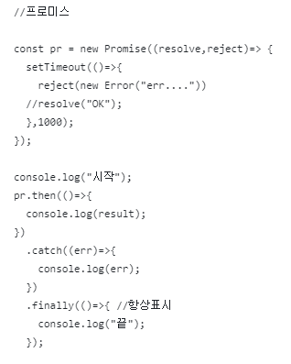
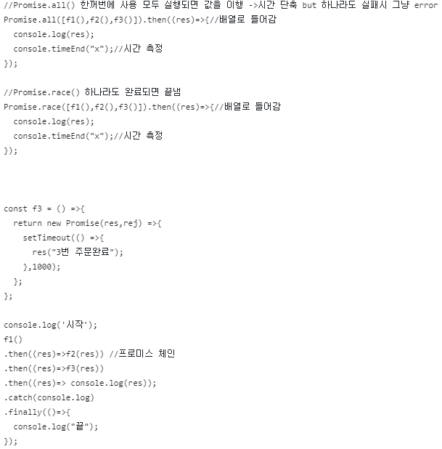
File Edit View Option
2080.06
MIRICOMPANY.COM
1
2
3
4
5
6
7
8
9
10
11
12
13
14
15
16
17
18
19
20
21
// Team Responsibilities
프로미스
<!-- FRONT END -->
PROGRAMMING PLAN
프로미스 ex)
01_ Project Overview
02_Project Features
03_Technology Stack
04_Team Responsibilities
05_Development Timeline
<!-- BACK END -->
06_Q & A
Promise(resolve,reject) // resolve: 성공 했을때 reject:실패 했을때 실행

Slide 16
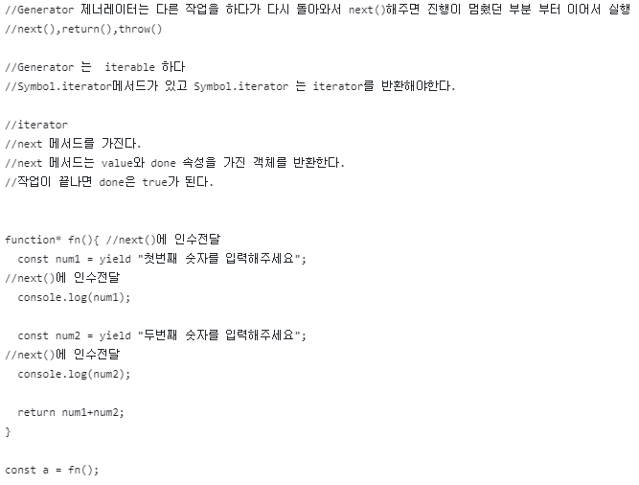
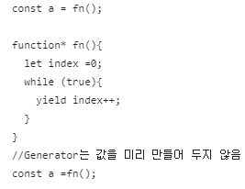
File Edit View Option
2080.06
MIRICOMPANY.COM
1
2
3
4
5
6
7
8
9
10
11
12
13
14
15
16
17
18
19
20
21
// Team Responsibilities
제너
레이터
<!-- FRONT END -->
PROGRAMMING PLAN
제너
레이터 ex)
01_ Project Overview
02_Project Features
03_Technology Stack
04_Team Responsibilities
05_Development Timeline
<!-- BACK END -->
06_Q & A

Slide 17



File Edit View Option
2080.06
MIRICOMPANY.COM
1
2
3
4
5
6
7
8
9
10
11
12
13
14
15
16
17
18
19
20
21
질문과
답변
<!---->
<!-- "Q & A" -->
자유롭게
질문해주세요!
PROGRAMMING PLAN
01_ Project Overview
02_Project Features
03_Technology Stack
04_Team Responsibilities
05_Development Timeline
--------------------------------------------------------------------------------
--------------------------------------------------------------------------------
06_Q & A
<!-- "발표자 정보" -->
발표자: 박동민(M)
이메일: focuspdm4383@naver.com
https://github.com/dongmin625/react-js-middle_class/tree/main
{thank you;

